Slide 1
CSET335L (Deep Learning)
Lecture 3: ANN backpropagation, Gradient Descent
Deepika Vatsa

Slide 2
Outline
Training a neural network
ANN backpropagation
Gradient Descent
Gradient descent algorithms

Slide 3
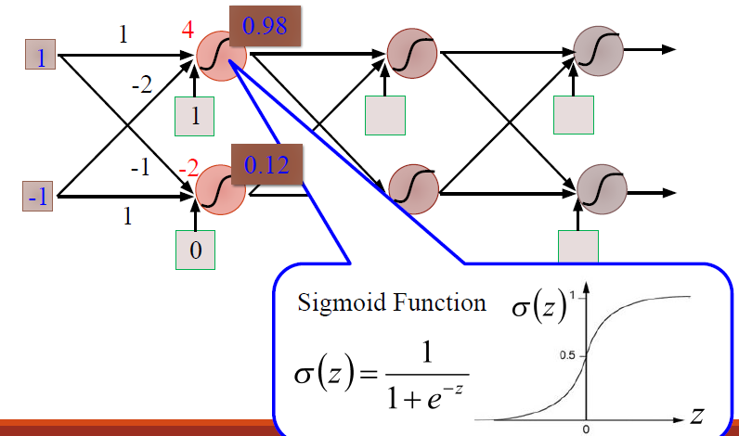
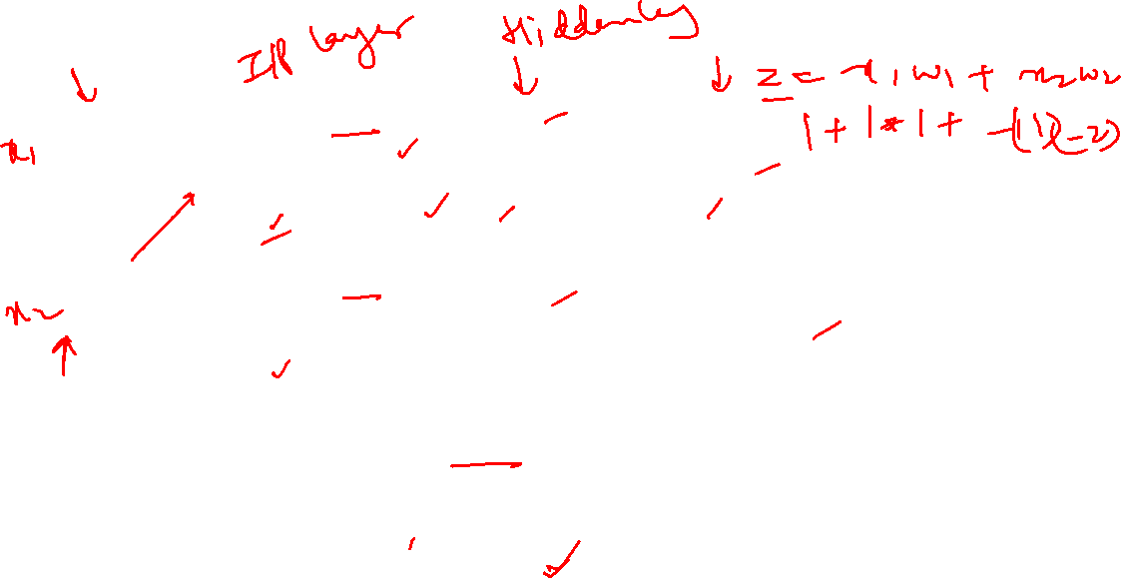
Example of Neural network

Slide 4
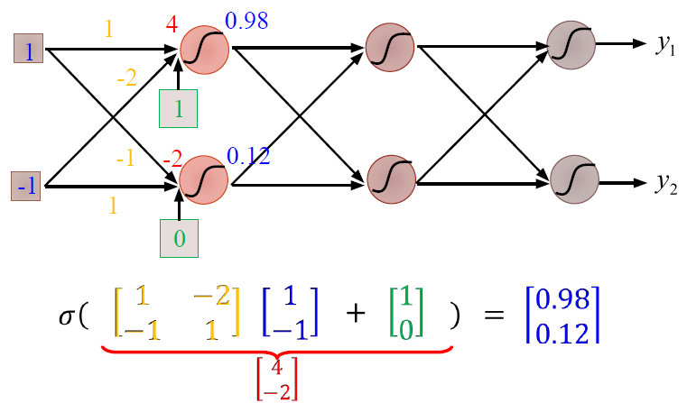
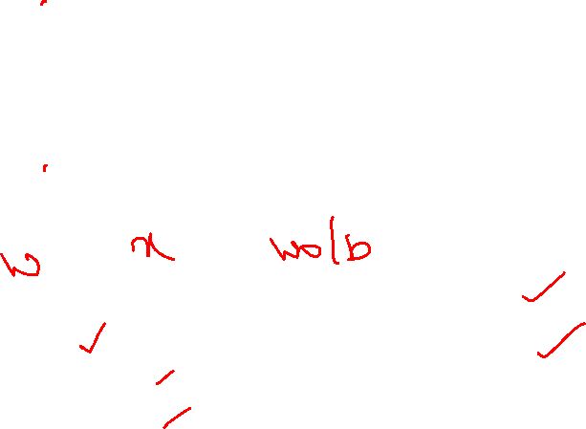
Example of Neural network

Slide 5
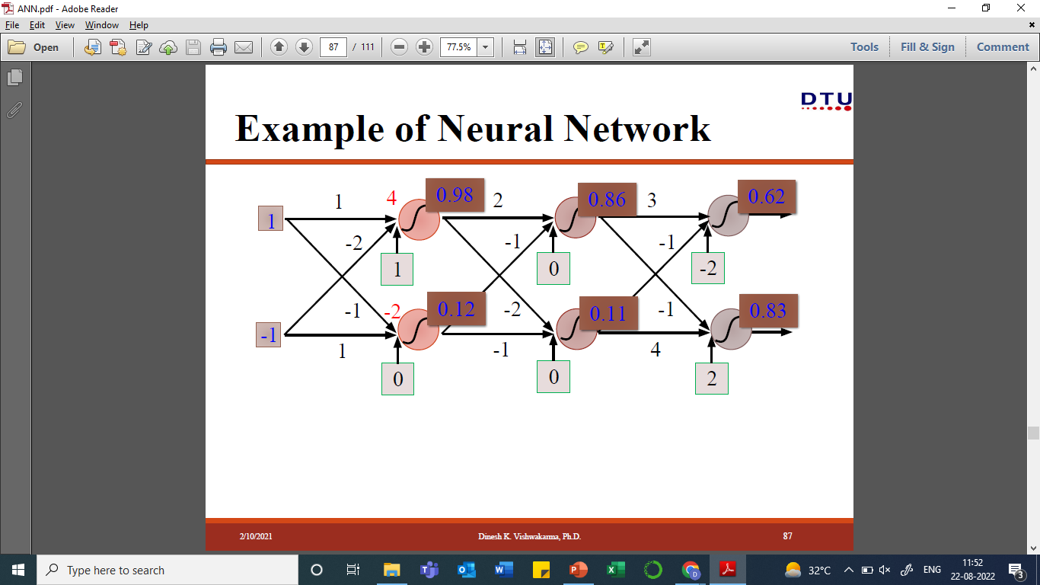
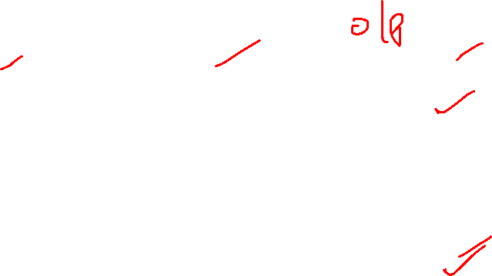
Example of Neural network

Slide 6
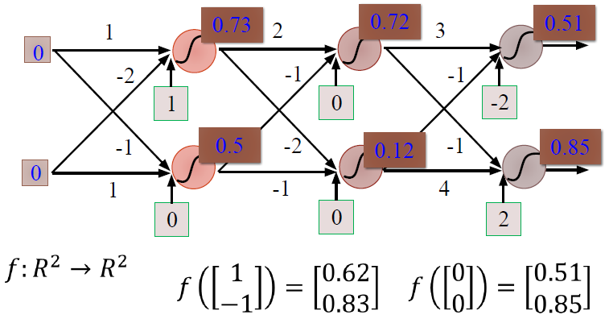
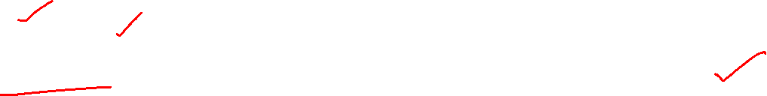
Example of Neural network

Slide 7
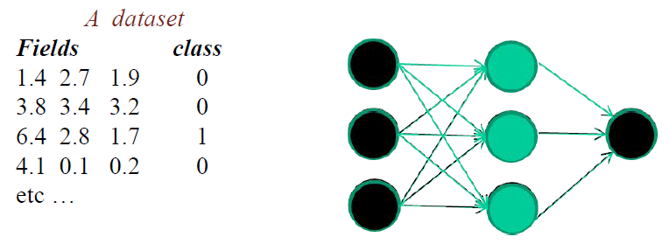
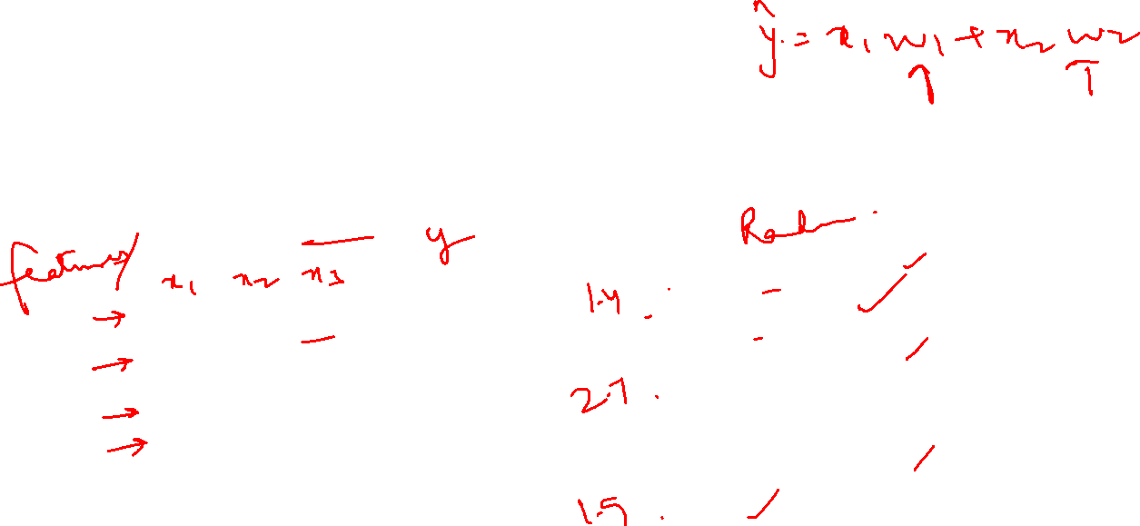
Training a Neural network

Slide 8
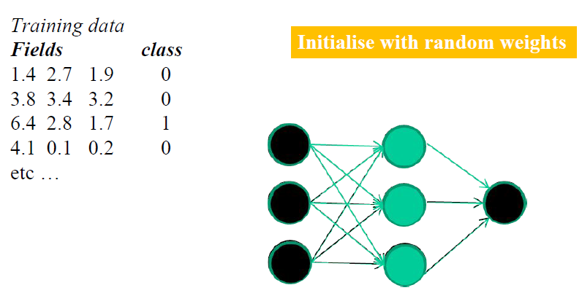
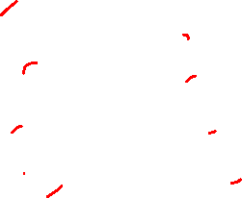
Training a Neural network

Slide 9
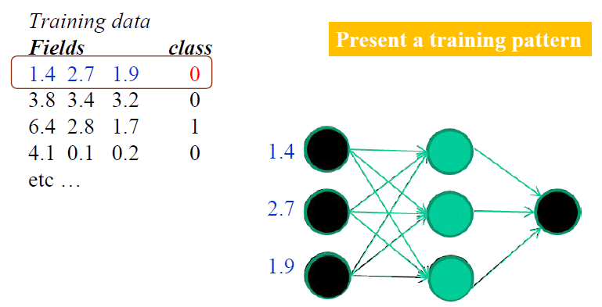
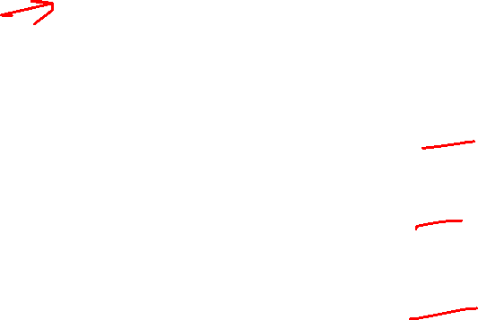
Training a Neural network

Slide 10
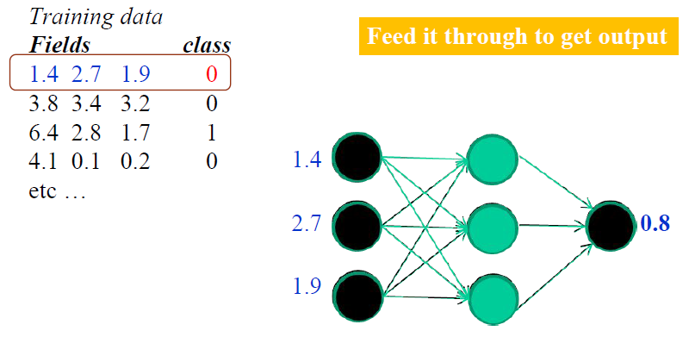
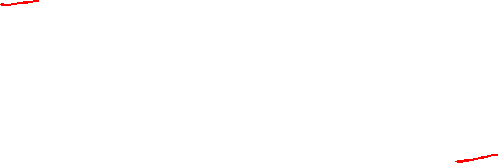
Training a Neural network

Slide 11


Training a Neural network

Slide 12
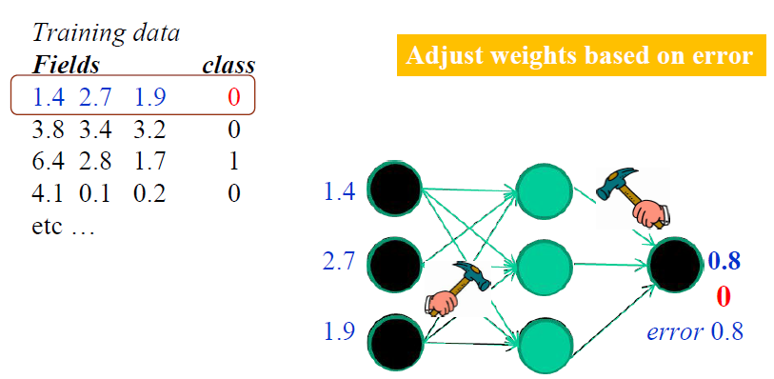

Training a Neural network

Slide 13

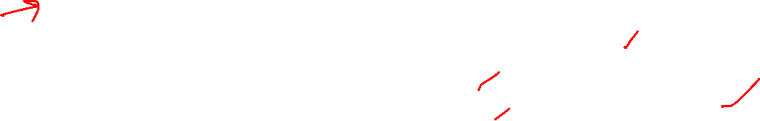
Training a Neural network

Slide 14
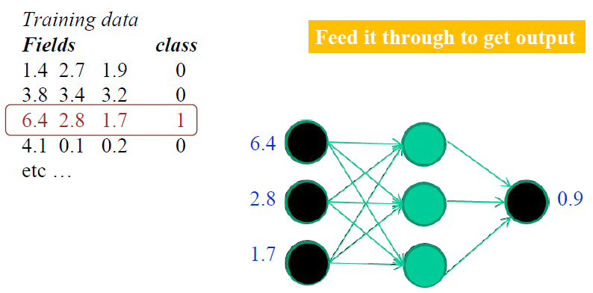
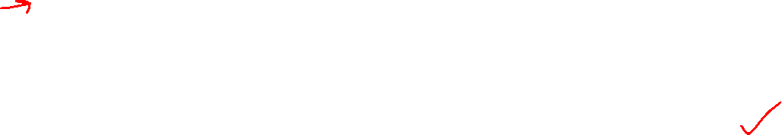
Training a Neural network

Slide 15
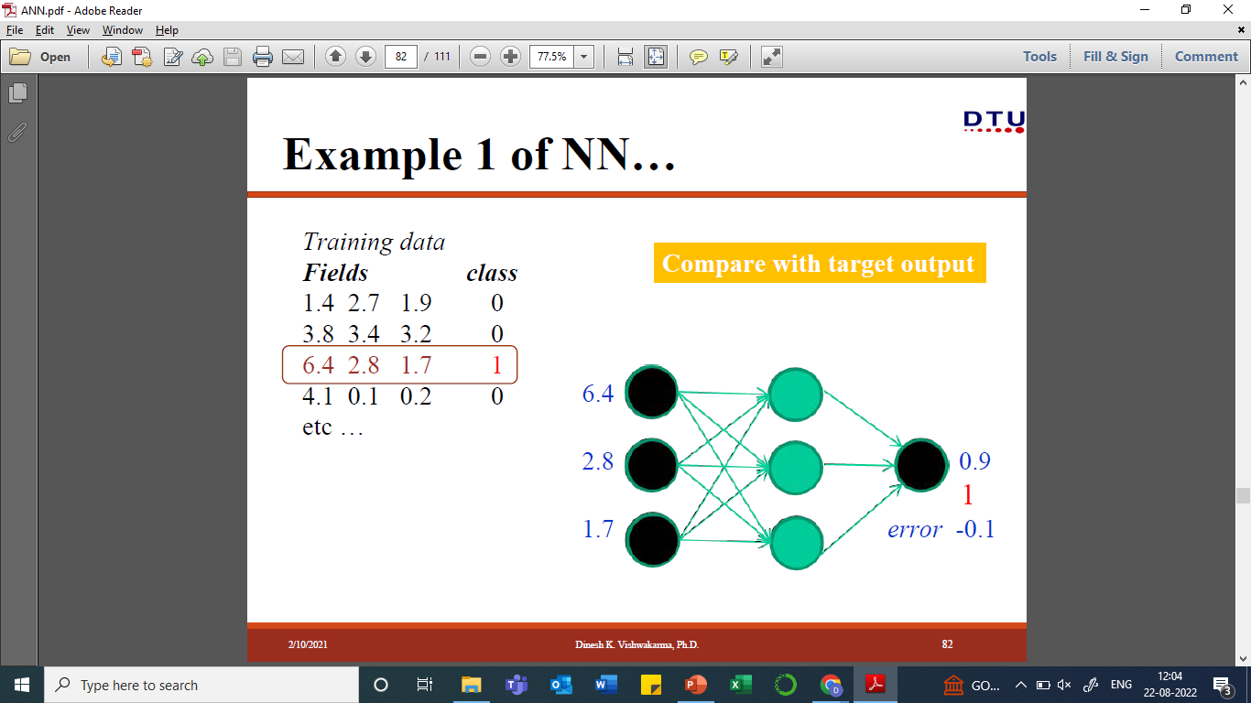
Training a Neural network

Slide 16

Training a Neural network

Slide 17
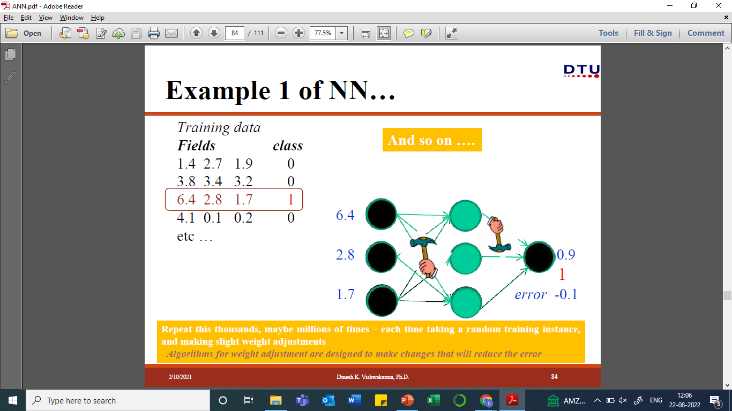
Training a Neural network

Slide 18
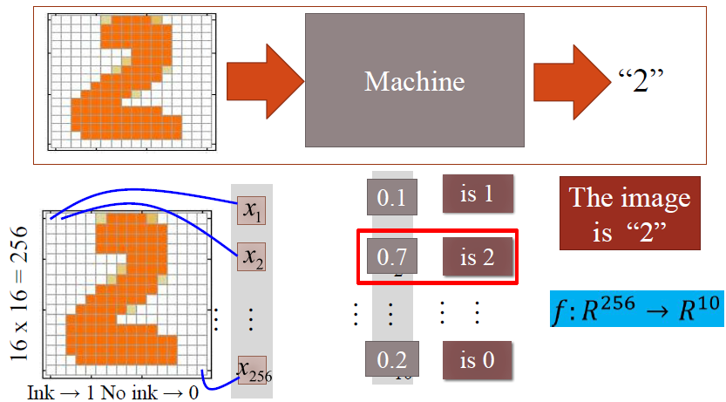
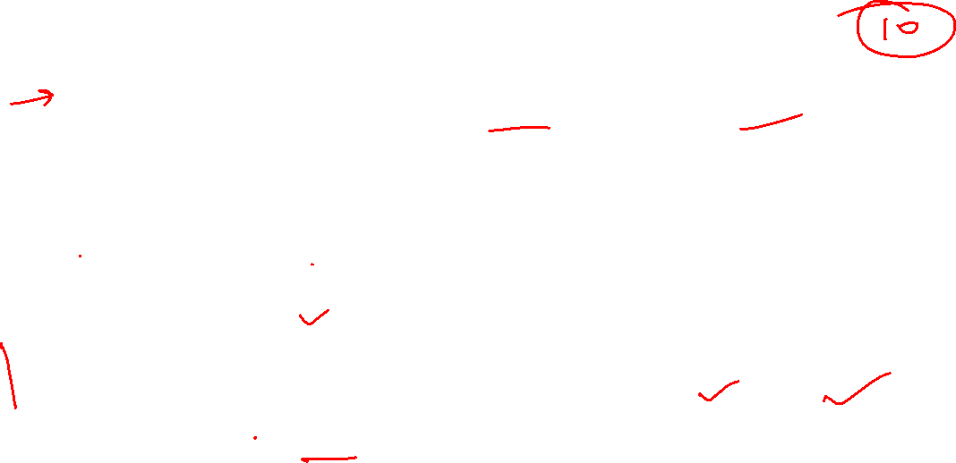
Example: Digit Recognition

Slide 19
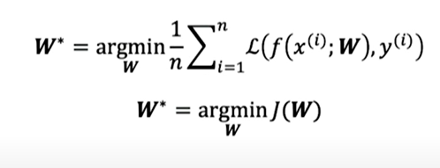
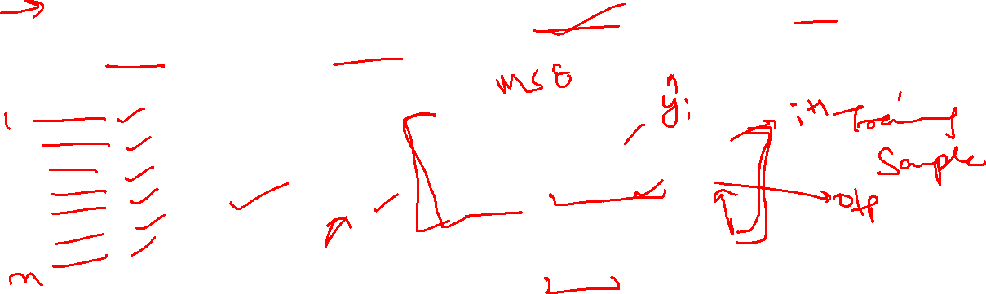
Training neural network
Loss optimization: Identify network weights such that the loss is minimum. Denoted as W*.
Notes:
We have the loss function for our model, now to train the neural network, we want to optimize the loss function
By loss optimization, we mean we want to find the network weights that achieve the lowest loss.
J(W) – empirical loss
Here, W is set of weights

Slide 20
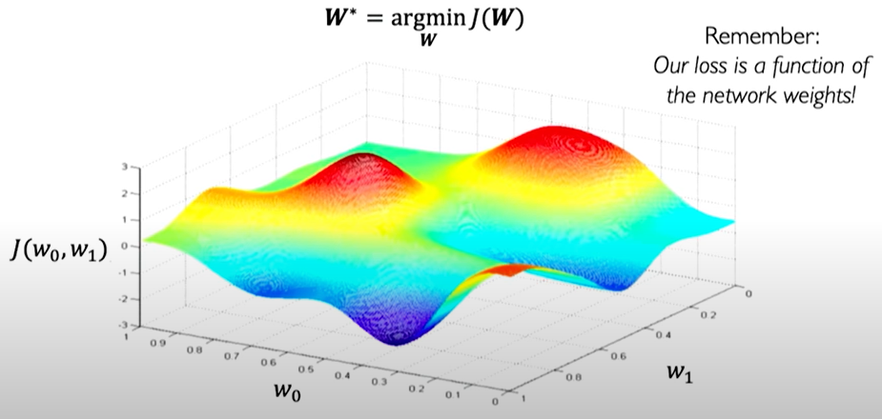
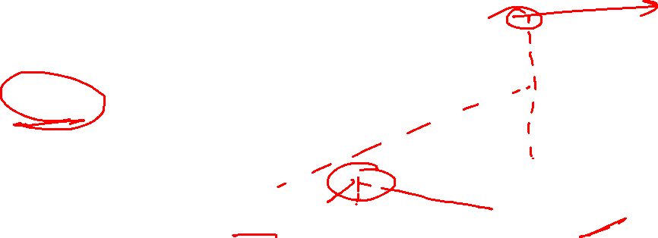
Loss optimization
Notes:
Lets say our loss function of two weights w0 and w1. so we can visualize it.
Here z axis is loss and a and y axis are the weights.
We want the value of weights w0 and w1 so that the loss is the minimum.
On this landscape, the dip will give us the min loss.

Slide 21
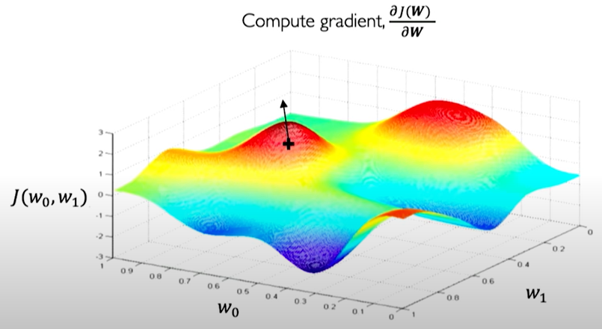
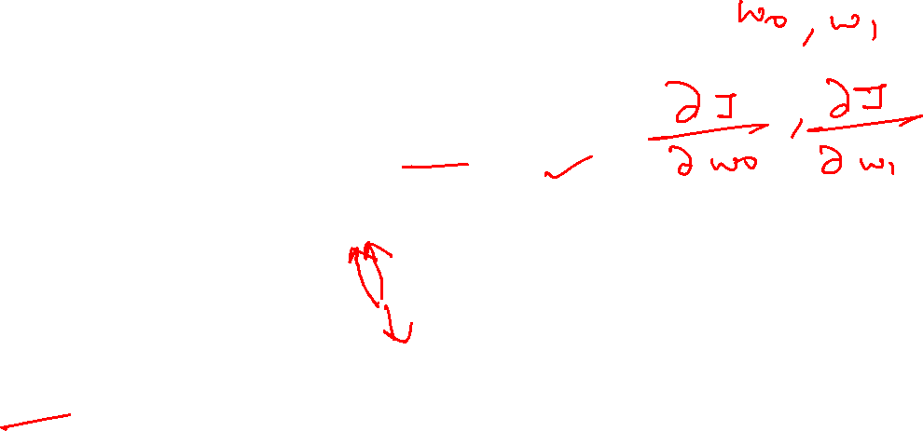
Loss optimization
Notes:
So we start from anywhere on the landscape. We randomly initialize values of w0 and w1.
And compute the gradient (first derivative) of the Loss function J. It gives us the direction which maximize the value of loss (J).
So move in the opposite direction of gradient to minimize the loss.
At the new point, again we will find the gradient and move in its opposite direction.

Slide 22
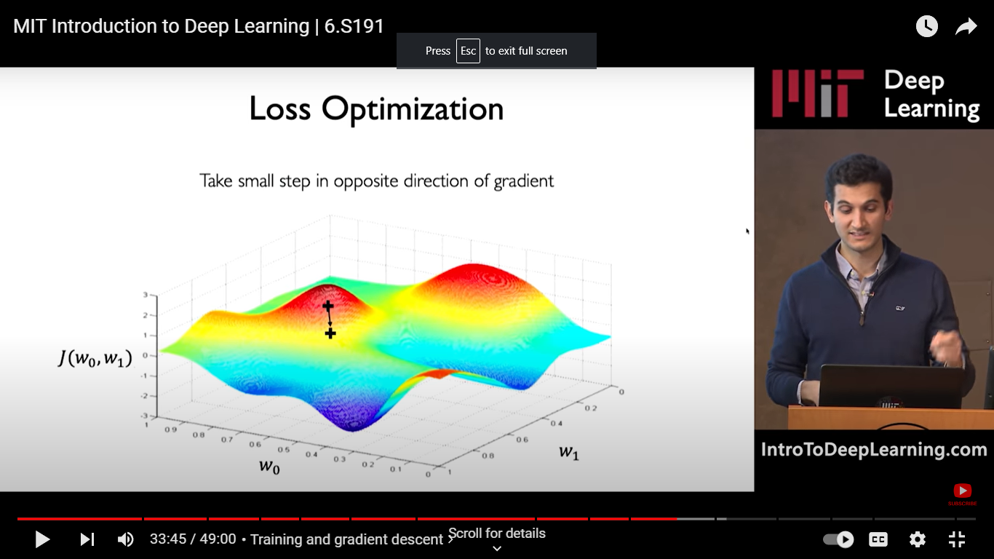
Loss optimization

Slide 23
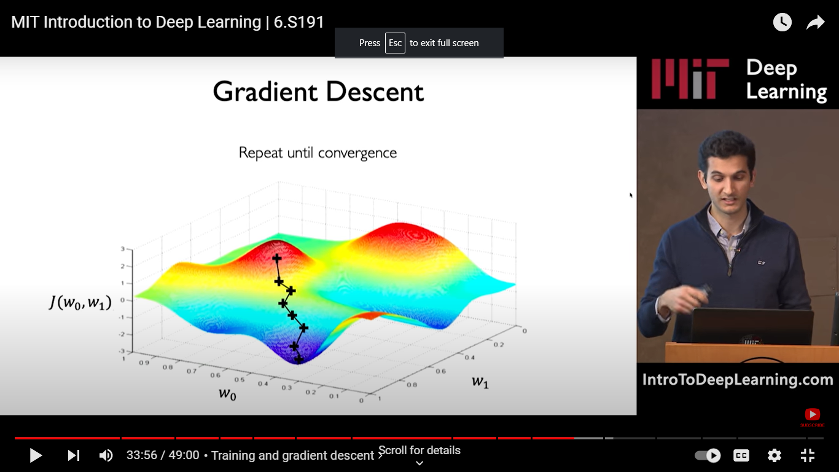
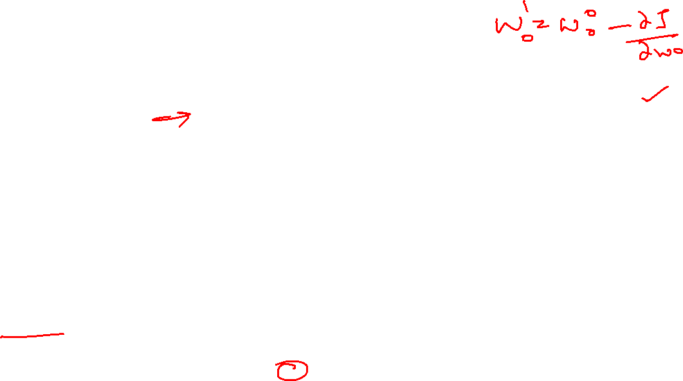
Gradient Descent
Notes:
We repeat the steps until we converge to a local minima. It can be global or local minima. This is called optimization that is we start from any random point on this landscape and move in a particular direction so as to obtain min loss.

Slide 24
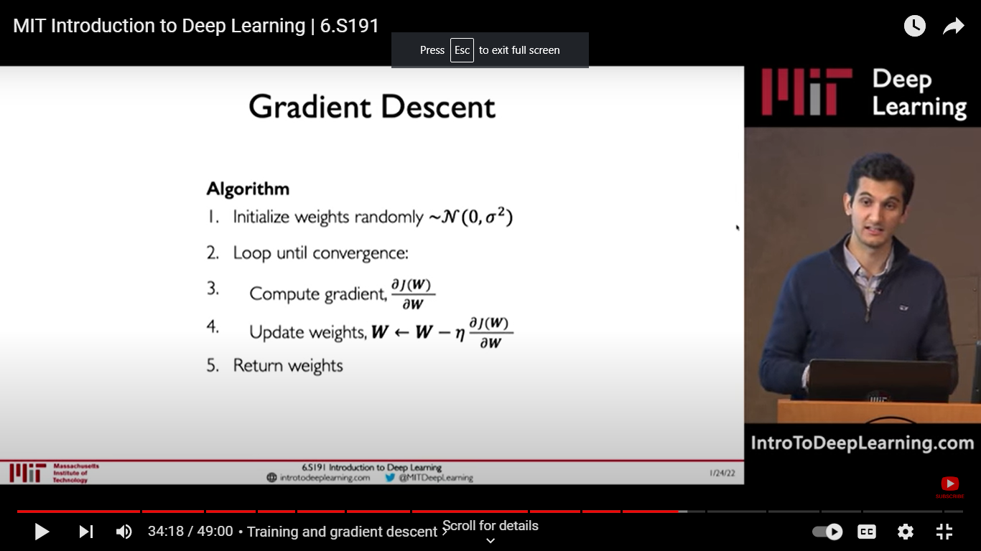
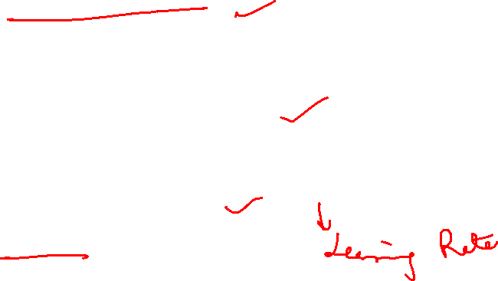
Gradient Descent
Notes:
Neta is the learning rate: defined the magnitude of the step that we take.
We need to understand how the gradient is computed for every single weight. The process is called backpropagation.

Slide 25
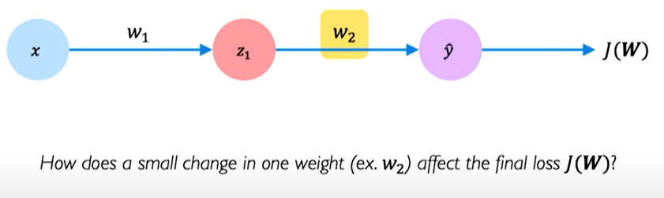
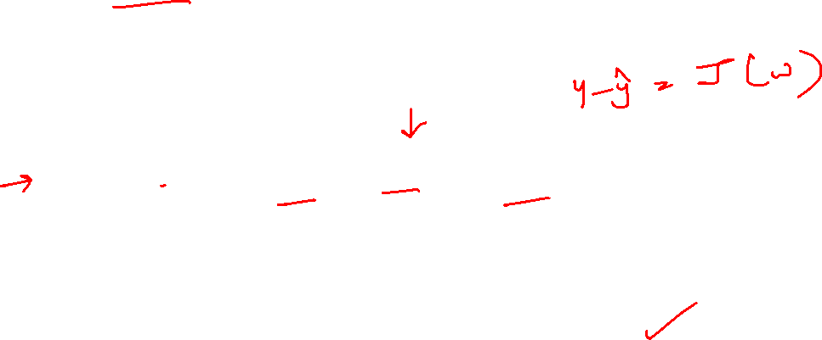
Calculating gradients: Backpropagation
Notes:
We need to understand how the gradient is computed for every single weight. The process is called backpropagation.
So we consider a smallest possible network having just one hidden neuron. So lets see how the gradient is computed here.
How small change in w2 affect the loss value. To know this we use the derivative of loss func through the output.

Slide 26
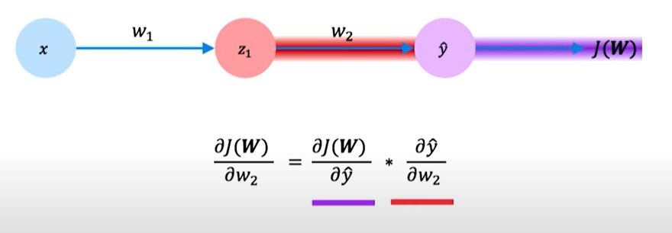
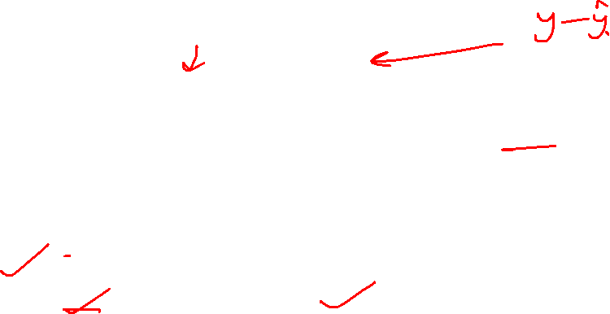
Calculating gradients: Backpropagation
Notes:
So applying chain rule, the derivative of J wrt w2 can be written as this. We did this because, J is dependent on y and y is dependent on w2.

Slide 27
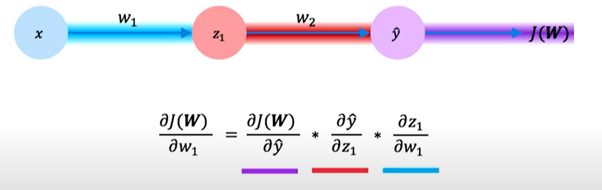
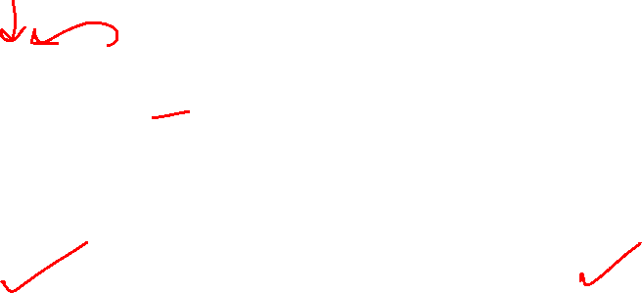
Calculating gradients: Backpropagation
Notes:
Similarly, to understand the impact of small change of w1 on J, we find the derivative of J wrt w1.
So this process of applying find derivative wrt to every weight is called backpropagation.
We repeat this for every weight in the network using gradients.

Slide 28
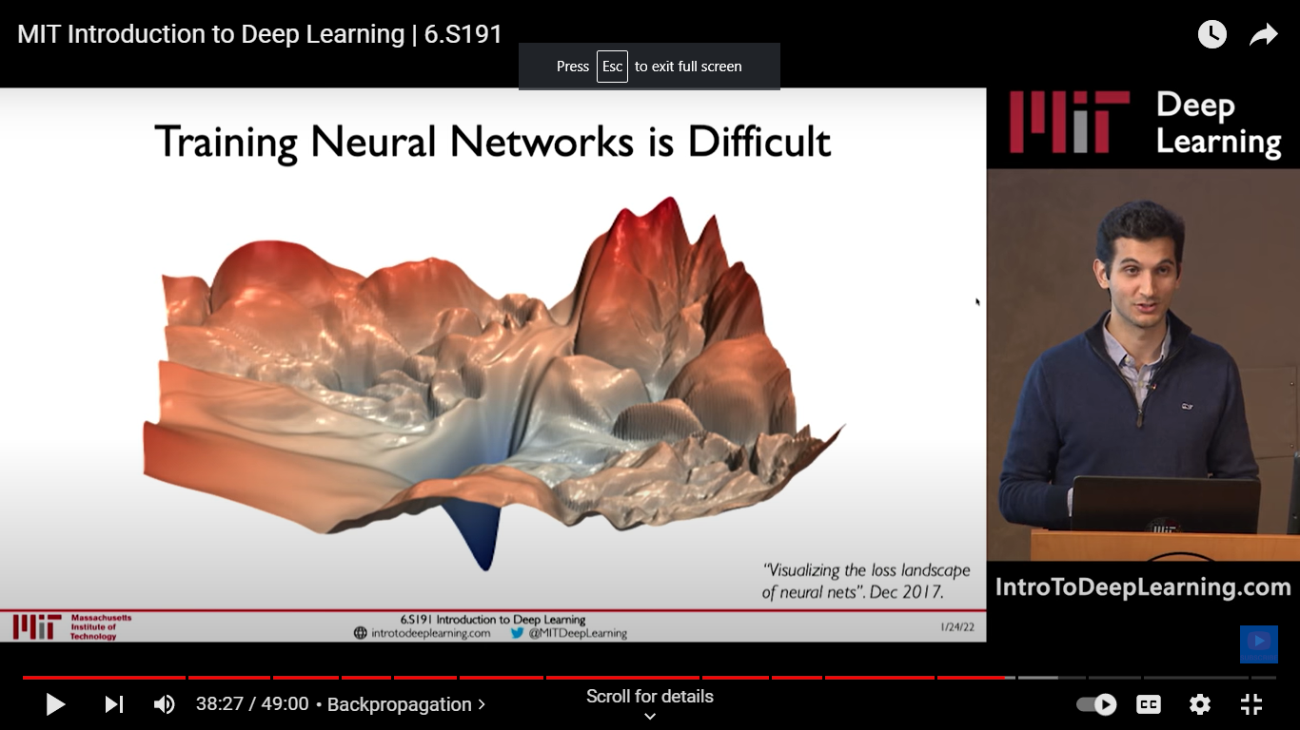
Training neural networks is difficult
Notes:
Practically, loss landscape looks something like this (very complex) and it is not easy to find the minimum loss.

Slide 29
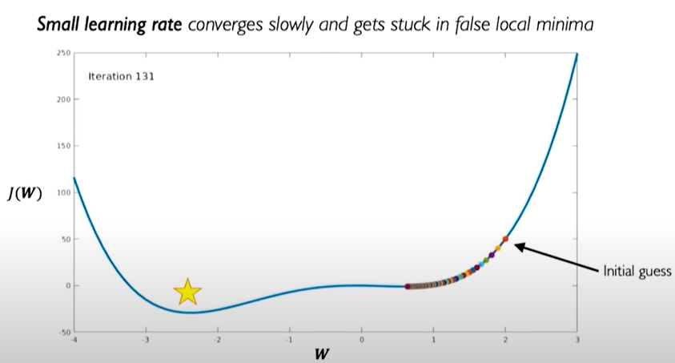
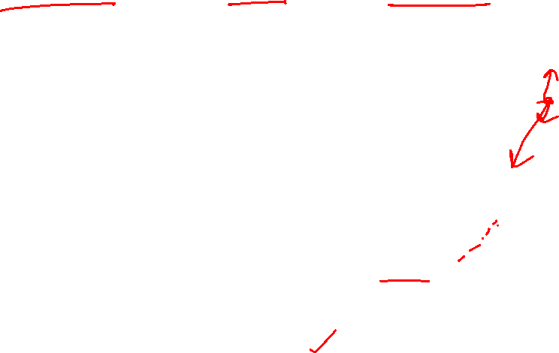
Gradient Descent: Learning Rate
Notes:
Taking small learning rate means taking small steps, we will converge very slowly and may lead to get stuck at local minima.

Slide 30

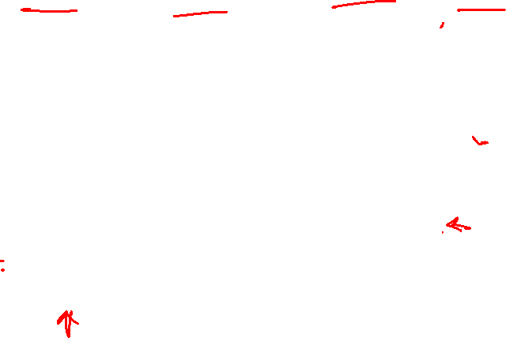
Gradient Descent: Learning Rate
Notes:
Large learning rates may overshoot and we miss the global minima. Not a stable training process.

Slide 31
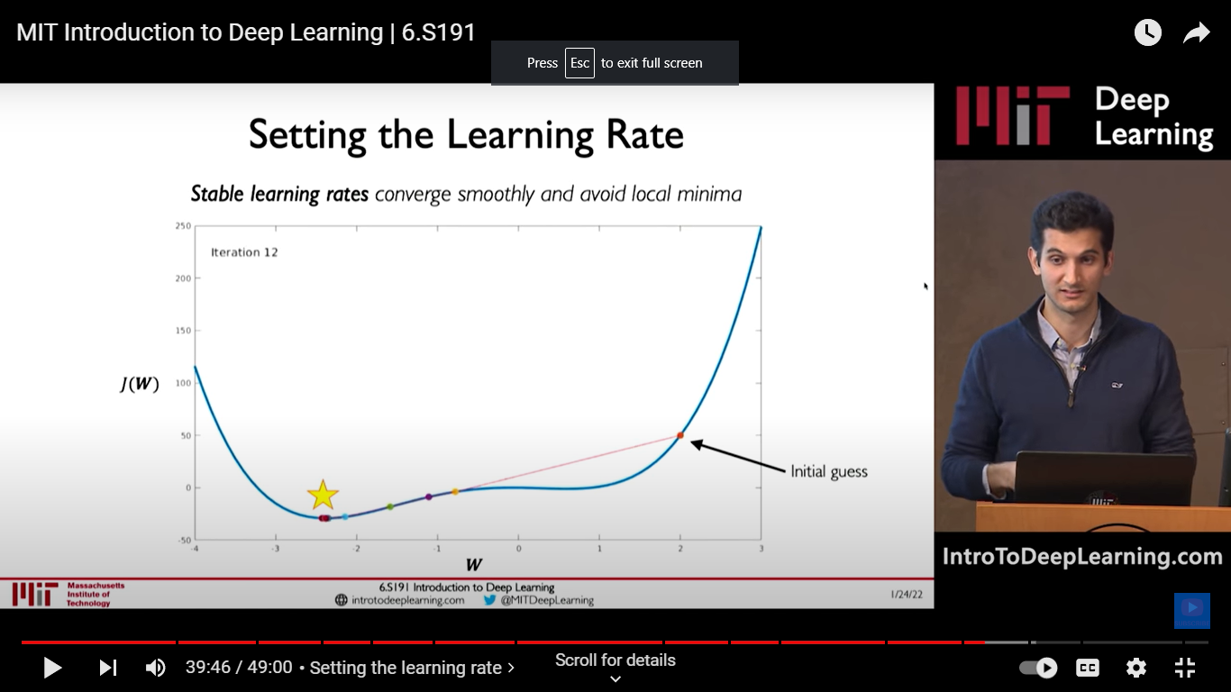
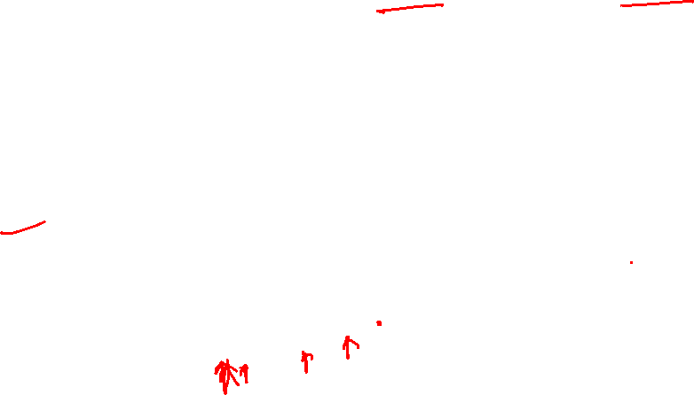
Gradient Descent: Learning Rate
Notes:
So we want to take medium learning rate so that convergence is stable (not too slow) and we still get to global minima.
There is no fixed value for medium size learning rate, so its arbitrary.

Slide 32
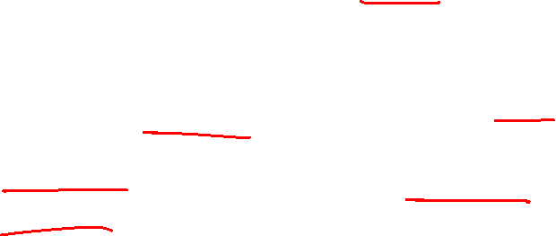
Gradient Descent: Learning Rate
Learning rate is a hyper parameter (that is, set by user)
Idea 1: Try num of different learning rates and go with the one that converges well. (Not satisfactory)
Idea 2: Use adaptive learning rates. Learning rates that can adapt themselves according to their landscape

Slide 33
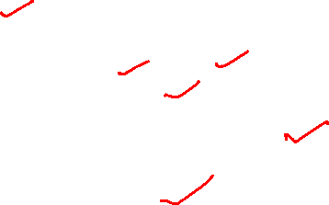
Gradient Descent: Learning Rate
Adaptive learning rate
Not fixed
Can be made larger or smaller depending on
How large gradient is
How fast learning is happening
Size of particular weights, etc.

Slide 34
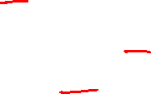
Gradient Descent Algorithms
Batch gradient descent
Stochastic gradient descent (SGD)
Mini batch gradient descent

Slide 35



Batch Gradient Descent
Take the entire training set, perform forward propagation and calculate the cost function.
Then update the parameters using the rate of change of this cost function with respect to the parameters.

Slide 36

Batch Gradient Descent
An epoch is when the entire training set is passed through the model, forward propagation and backward propagation are performed and the parameters are updated.
In batch Gradient Descent since we are using the entire training set, the parameters will be updated only once per epoch.

Slide 37

Batch Gradient Descent
We go through all training samples and calculate cumulative error. Then we backpropagate and adjust weights.
Good for a small training set
Gradient descent is computationally intensive since our data set is huge.
Not feasible to train on every training sample.
Notes:
The gradient is very computationally intensive to compute. When our data set is huge because obviously we need a large amount of data to train our network, therefore there will be too many weights. So computing gradient for each weight will consume a lot of time, thus what we can do in that case, we create batches of our data set and then train our network.

Slide 38

Stochastic gradient descent (SGD)
Take first observation randomly, then pass it through the neural network, calculate the error and then update the parameters.
Then take second observation and perform similar steps with it.
This step will be repeated until the specified number of epochs, or for some approximate loss value
Notes:
Disadvantage of sgd is noisy gradient since only one sample is used to compute it. Therefore the middle ground is mini batch gradient descent.

Slide 39

Stochastic gradient descent (SGD)
Each time the parameter is updated, it is known as an Iteration. Here since we have 5 observations, the parameters will be updated 5 times or we can say that there will be 5 iterations.
Had this been the Batch Gradient Descent we would have passed all the observations together and the parameters have been updated only once.
In the case of SGD, there will be ‘m’ iterations per epoch, where ‘m’ is the number of observations in a dataset.

Slide 40


Stochastic Gradient Descent (SGD)
Use a single observation to calculate the cost function and weight updation
Good when the training set is very big and we don’t want too much computation.
Easy to compute and noisy gradient (stochastic)
Notes:
Disadvantage of sgd is noisy gradient since only one sample is used to compute it. Therefore the middle ground is mini batch gradient descent.

Slide 41


Mini batch Gradient Descent
Similar to SGD. But instead of choosing one randomly selected training sample, we use a batch of randomly selected samples.
Fast to compute and gives a much better estimate of the true gradient
Notes:
Disadvantage of sgd is noisy gradient since only one sample is used to compute it. Therefore the middle ground is mini batch gradient descent.

Slide 42


Mini batch Gradient Descent
Example: batch size = 2
Take two observations randomly, pass them through the neural network, calculate the error and then update the parameters.

Slide 43

Mini batch Gradient Descent
Then take another two observations randomly and perform similar steps i.e., will pass through the network, calculate the error and update the parameters.

Slide 44

Gradient Descent algorithms
Advantages of Mini batch gradient descent:
Better estimation of the gradient
Allows for smoother convergence
Allows for using larger learning rates
Faster training through parallelizing the computation of gradients of each element of a batch and thus take the average of all gradients
Notes:
Also, parallelize computation of each element in batch and thus take the average of all gradients

Slide 45


Drawback of Gradient Descent algorithms
Mini-batch tries to strike a balance between the goodness of gradient descent and speed of SGD.
Notes:
Gradient Descent uses the whole training data to update weight and bias. Suppose if we have millions of records then training becomes slow and computationally very expensive.
SGD solved the Gradient Descent problem by using only single records to updates parameters. But, still, SGD is slow to converge because it needs forward and backward propagation for every record. And the path to reach global minima becomes very noisy.
Mini-batch GD overcomes the SDG drawbacks by using a batch of records to update the parameter. Since it doesn't use entire records to update parameter, the path to reach global minima is not as smooth as Gradient Descent.

Slide 46
Acknowledgements
The contents of this lecture are taken from:
MIT Introduction to Deep Learning | 6.S191 by Alexander Amini
https://www.youtube.com/watch?v=7sB052Pz0sQ&list=PLtBw6njQRU-rwp5__7C0oIVt26ZgjG9NI
More reading on gradient descent:
https://sebastianraschka.com/faq/docs/gradient-optimization.html

